Slide 1
Genome-Wide Association Studies
Mohsin Ali, PhD

Slide 2

Prerequisites
https://github.com/mohsinali1990/QAU_R_Training.git
Laptop with installed R-studio
Internet
Input files

Slide 3
Outlines
How to select trait of interest?
Marker trait association methods: QTL mapping and GWAS
QTL mapping vs. GWAS
Overview of required population for QTL mapping and GWAS
Power of GWAS analysis
Population structure
Genetic relationships
GWAS models
GWAS analysis in RStudio

Slide 4
Introduction
Qualitative traits - few genes, with large effect, low environmental bias, and high h²
Quantitative traits - many genes, little effect, with high environmental bias, and low h²
How to select for these traits?
Traditional breeding (simply phenotypic selection)
Molecular markers linked with QTL
Marker assisted selection (QTL with large effect)
Genomic selection (many QTL with small effect)

Slide 5
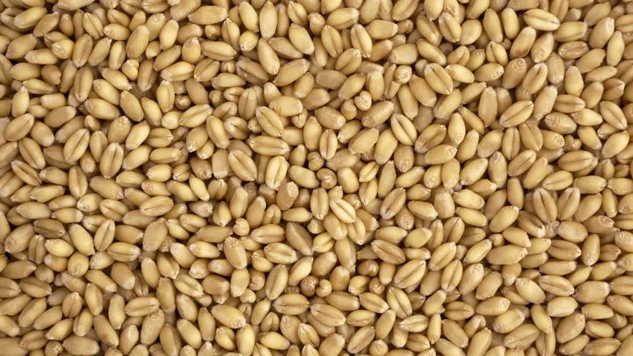
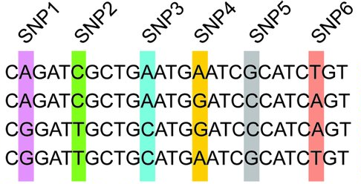
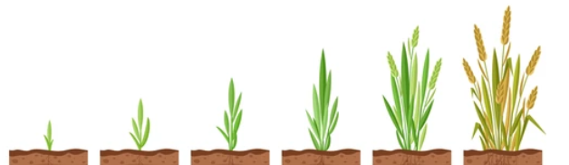
Introduction cont.
GWAS is more interested to correlate marker variants with trait variation using association analysis regardless of phenotypic differences observed between individuals
Also, how its passed to next generation
Seed color
Molecular diversity
Plant height

Slide 6
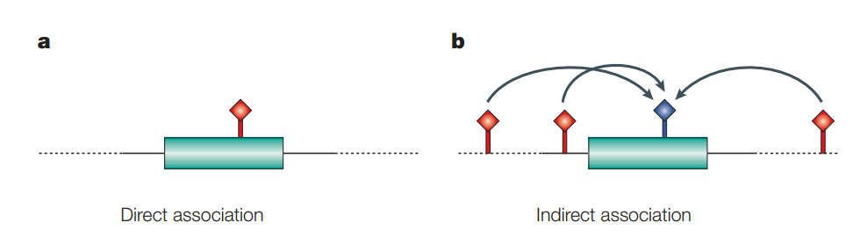
Introduction cont.
b) Functional SNP (blue) was not genotyped, but number of other SNPs (red), in high LD with the functional SNP, were genotyped. So, indirect association was detected
a) Functional SNP (red) was genotyped and an a direct association was detected
(copy from Hirschhorn and Daly 2005, Nat. Gen.)
Notes:
a | A case in which a candidate SNP (red) is directly tested for association with a disease phenotype. For example, this is the strategy used when SNPs are chosen for analysis on the basis of prior knowledge about their possible function, such as missense SNPs that are likely to affect the function of a candidate gene (green rectangle). b | The SNPs to be genotyped (red) are chosen on the basis of linkage disequilibrium (LD) patterns to provide information about as many other SNPs as possible. In this case, the SNP shown in blue is tested for association indirectly, as it is in LD with the other three SNPs. A combination of both strategies is also possible.

Slide 7
Marker trait association (MTA)
How to detect MTA?
QTL mapping based on bi-parental population
It is still a powerful method to identify regions of the genome that co-segregate with a given trait
F_{2:3} populations or Recombinant Inbred Line (RIL) families
Some limitations of QTL mapping:
Its limited between two parents of particular cross
Lower resolution
Few recombination events happens during creating of RIL
Bi-parental population need to be created and its time demanding procedure

Slide 8
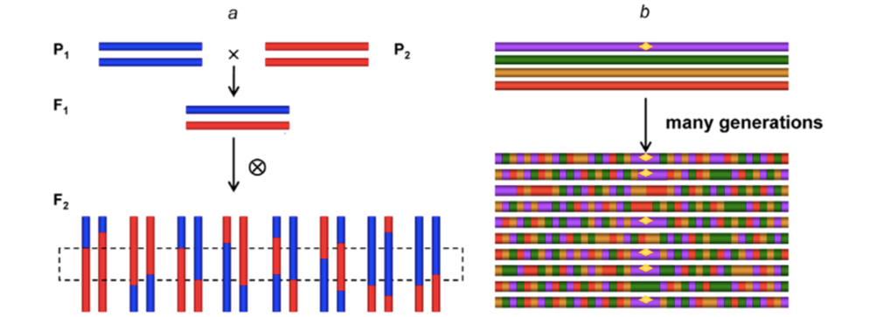
GWAS vs. QTL mapping
Statistical methods use whole genome markers to find genetic variations associated with a trait
Genotyping
QTL mapping (using F₂ design)
GWAS (natural population)
Phenotyping
Few recombination events
Historical and natural recombination
Notes:
b) Yellow dot is functional locus

Slide 9
GWAS advantages
High-resolution power due to high amount of historical recombination
Low LD
High genetic diversity (diverse populations)
Biological adaptation and geographical distribution
No need to create mapping population (time saving)
Study various regions of the genome simultaneously
Greater capacity for detecting more alleles

Slide 10
GWAS limitations
Reproducibility: sometimes results are not replicated across populations
Results need to validate by replication in independent samples in different populations (validation test)
Size of population: population should be enough large to detect a QTL (statistical power)
Marker dataset size: a large number of markers is required to cover the whole genome
Detects association not causation
Noncoding variants with unknown effect: most of the identified variants in GWAS are far from discovered protein-coding gene
Detection of rare variant: detects only variants that their frequency >5% in a population

Slide 11
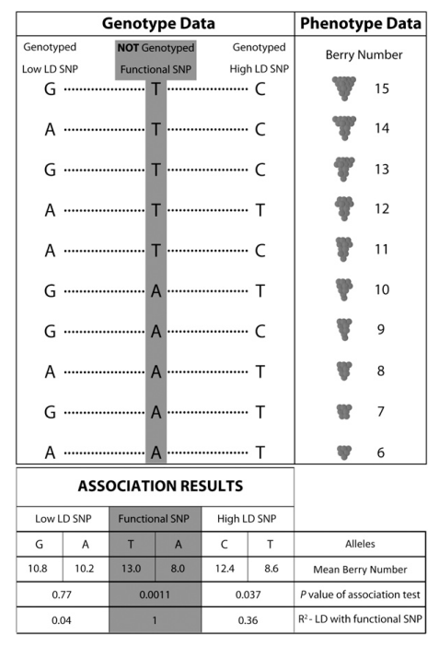
GWAS as known as linkage disequilibrium mapping
LD is non random association between two or more loci
In general, the strength of the correlation between two markers is a function of the distance between them: the closer two markers are, the stronger the LD
(copy from Myles et al 2009, Plant Cell)

Slide 12
GWAS assumptions
Genetic variants contribute to development of trait
A marker associated with a certain trait is in or near a gene that contributes to that trait
Common variants explain a significant proportion of the genetic variation in the population
Population homogeneity

Slide 13
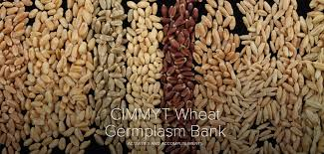
GWAS populations
Pool of genotypes from a breeding program
Multiple cross populations: NAM, MAGIC
Lines derived from diallel crosses (mating scheme used by plant breeders)
Germplasm collection: landraces, accessions

Slide 14
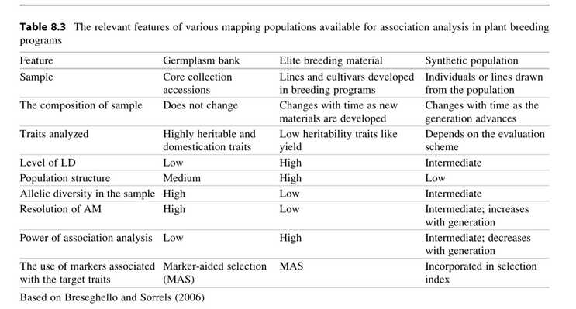
GWAS populations

Slide 15
Power of GWAS
Proportion of phenotypic variation explained by the SNP – increase the heritability
The effect size of the two allelic variants: how they differ in their phenotypic effect (no way to change)
Sample size (evaluate more individuals)
Population structure: introduce heterogeneity resulting in an association that is not true
Geographical distribution
Growth habit: winter and spring wheat
Unequal familial relationship
Different LD pattern

Slide 16
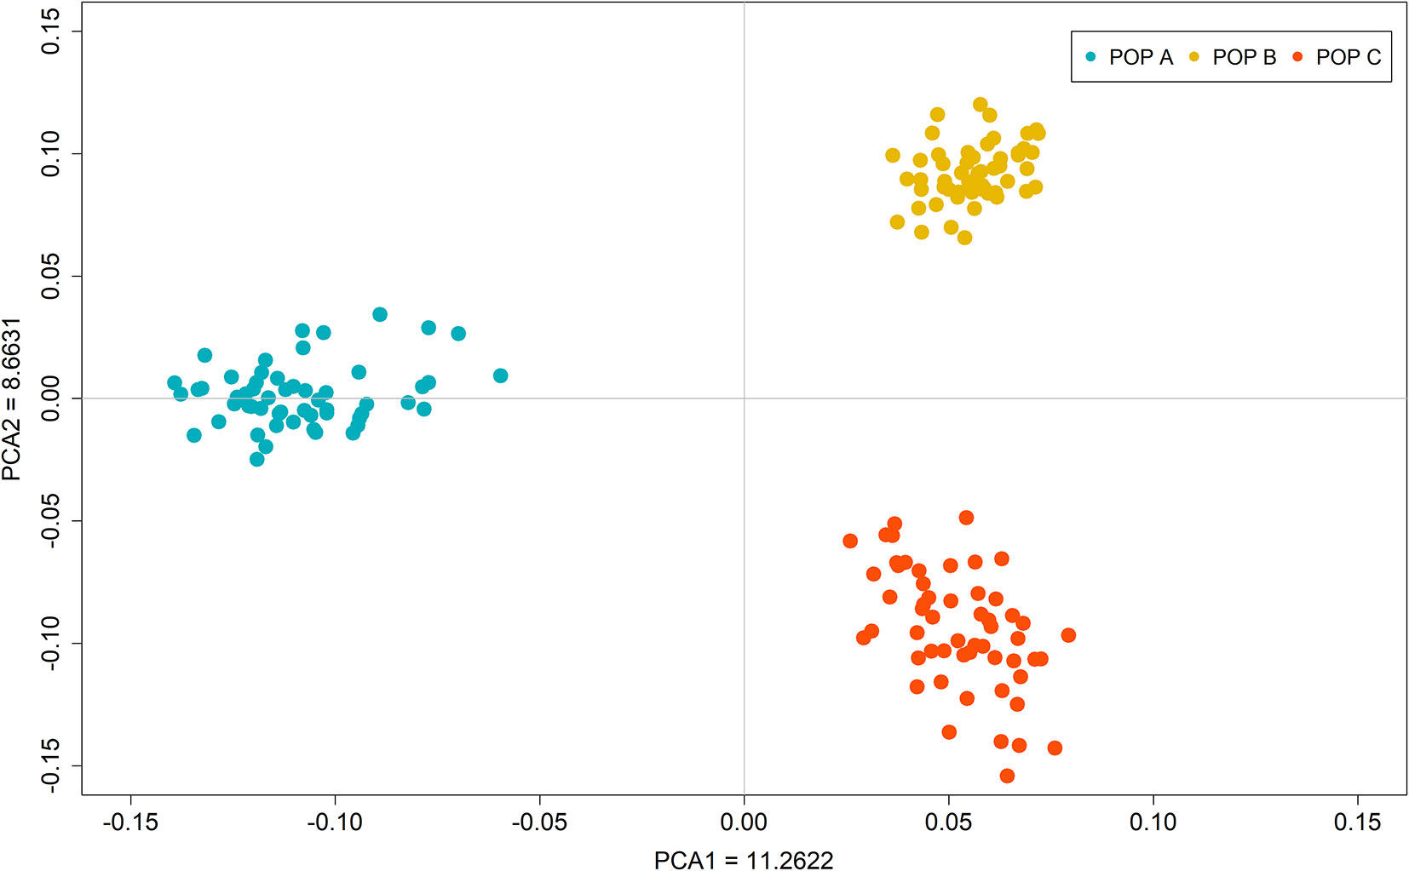
Population structure
Systematic difference in allele frequencies between subpopulations
May be due to different ancestry: geographical and climate distance, familial relationship, …
It ends up in spurious association ==> False positives (Type I error)
Over estimation of significance of associations
Solution: regression on principal component of PCA
Including 1-3 PCs in the mixed linear model

Slide 17
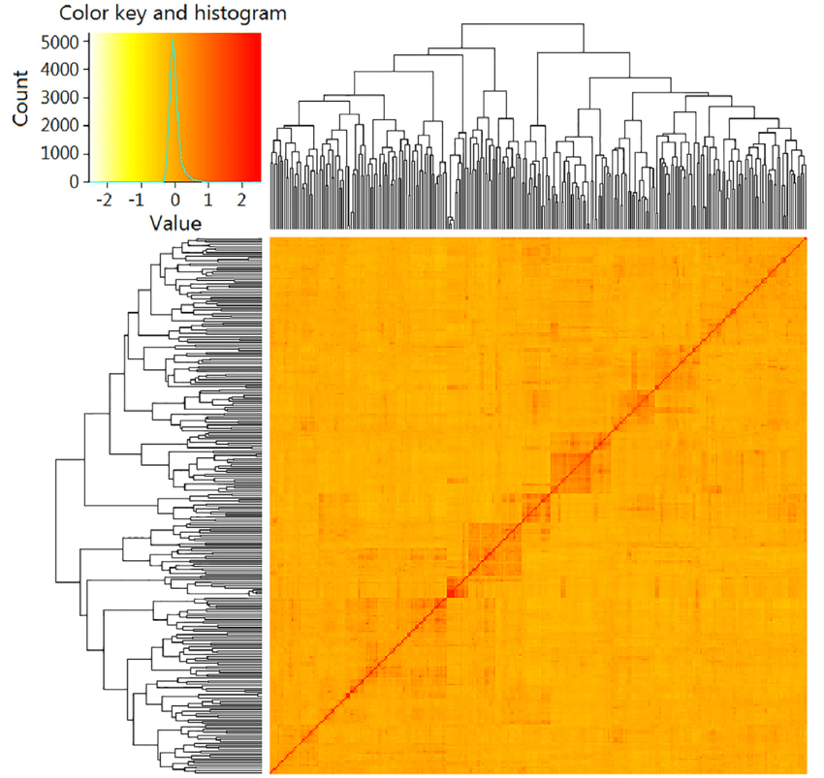
Genetic relationship
Coefficient of coancestry: the probability that an allele selected randomly from individual X and an allele selected randomly from the same autosomal locus of individual Y are in identity by descent (IBD)
K (kinship) = twice of the coancestry
Genomic relationship matrix (G or K )
Molecular markers are using to estimate relationship

Slide 18
GWAS models
GLM: all the factors included in a GLM are fixed effects
GLM solves for each trait and marker information
Includes:
Phenotypic dataset (e.g. adjusted mean values for each genotype)
Marker data (e.g. SNP)
Covariates
Any covariates that can be used to control field variations, and individuals (e.g. winter and spring wheat, geographical distribution, fertility variation of field ,...)1
1-3 PCs (or Qs) to control population structure
MLM: Factors in MLM include both fixed and random effects
Individuals in MLM are random
Kinship matrix added to MLM to control unequal familial relationship

Slide 19
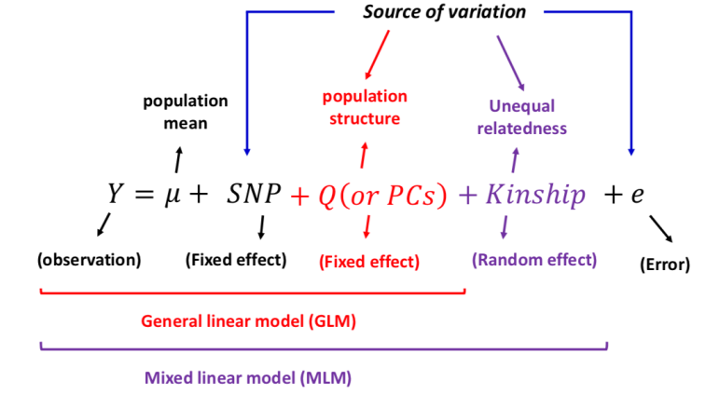
GWAS models concept

Slide 20
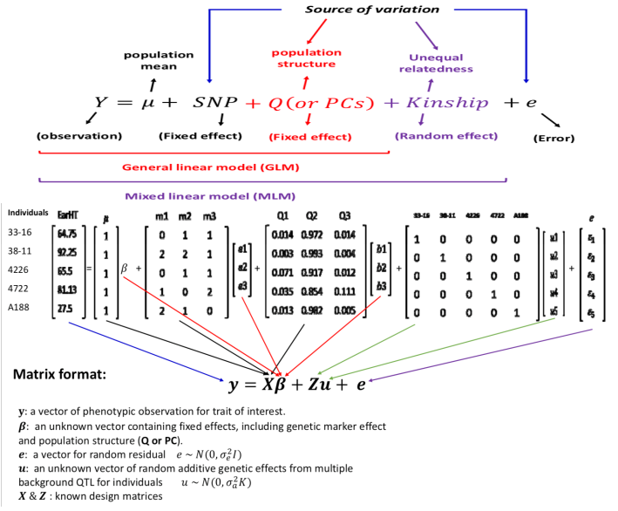
GWAS model example from TASSEL tutorial dataset

Slide 21
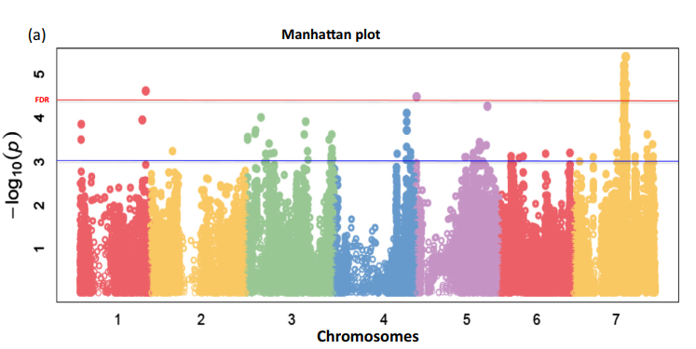
Manhattan plot
It is a graphical tool to show significant hits associated with the trait under test
Each data point represents a genotyped SNP, ordered across the chromosomes (Xaxis)
Yaxis = -log(p-value)

Slide 22
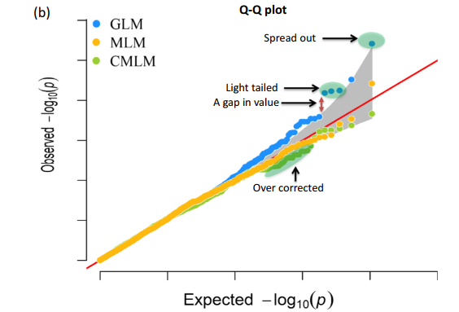
Quantile-quantile (QQ) plot
It is a plot of the quantile distribution of observed p-values (on the y-axis) on the quantile distribution of expected p-values (on x-axis)
If a QQ plot is a line with a tail, there are some casual polymorphisms

Slide 23
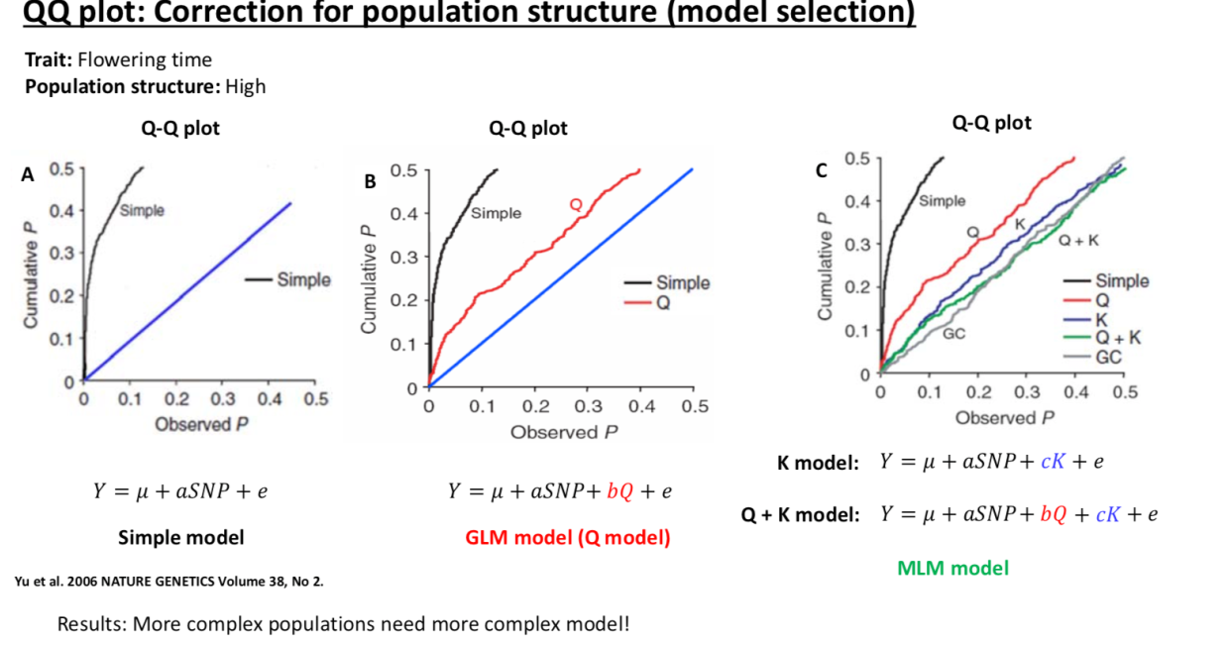
QQ plot statistical tool used to visualize GWAS output and power

Slide 24
GWAS analysis in R using rMVP and mrMLM R package

